Slide 1
Machine Translation
W266: Natural Language Processing

Slide 2
Peeking ahead...
Week 1- 2: NN Basics & Training
Week 3: Classification & Sentiment
Week 4: Part of Speech + Parsing
Week 5: Convolutional Neural Networks (CNNs)
Week 6 - 7: Language Models
Project Proposal Past Due
Week 8: Machine Translation
Week 9: Advanced MT: Transformers & Transfer Learning
Week 10: Entities/Information Extraction
Week 11: Summarization and a touch of question answering
Week 12: Document Classification
Week 13: Information Retrieval

Slide 3
Announcements
Proposal Comments - ✅ complete (?)
Please reach out if you haven’t received comments on your proposal
Assignment 6 (Machine Translation) - to be released Saturday 02/27
Due Sunday, Mar 7 (Tuesday 03/09 if you use late days)
Paper reading sessions:
Grammar as a Foreign Language
Mark: This Thursday 02/25 5:40 pm PST
Toward a better trade-off between performance and fairness with kernel-based distribution matching
Peter: Next Tuesday 03/02 3:40 pm PST
Code Walk Through:
BERT as a Black Box
Joachim: Tuesday 02/23 Noon PST

Slide 4
Key Learnings Review

Slide 5

Last Week: Language Models with RNNs
*Image: http://colah.github.io/posts/2015-08-Understanding-LSTMs/
NEXT WORD’s PROB DISTRIBUTION
P(Y₁)
P(Y₂)
P(Y₃)
SOFTMAX
P(Y₁): should score ‘the’ high..
Softmax
Softmax
Softmax
AFFINE LAYER (can be preceded by FCC layers)
Affine
Affine
Affine
P(Y₂): should score ‘world’ not zero’..
RNN* (LSTM) (one or more layers)
P(Y₃): should score ‘is’ not zero’..
EMBEDDINGS
Language Model: P(Y) ~ ∏ P(Y_{i}|Y_{i-1}..Y₁)
TEXT TOKENS
<s>
the
world
SENTENCE
“The world is … “

Slide 6
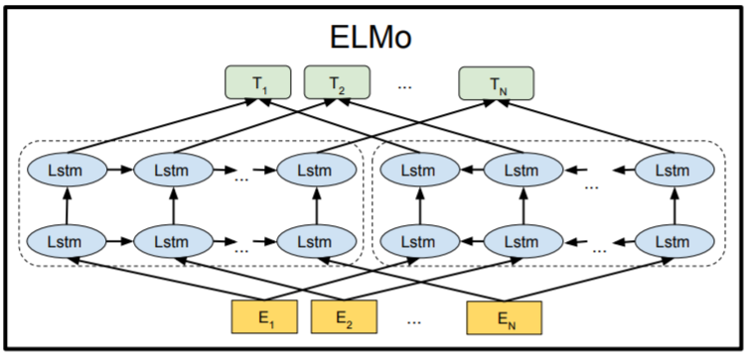
Last Week: ELMo
Paper with deep insight: ”Deep contextualized word representations”, Peters et al, https://arxiv.org/pdf/1802.05365.pdf
Word vectors with context!
Bi-directional LSTM architecture, trained on 1bn+ word corpus on LM task
Final forward/backward vectors are concatenated
Model also returns output for intermediate layers
Image Source: ”BERT: Pre-training of Deep Bidirectional Transformers for Language Understanding”, Devlin et al, ,https://arxiv.org/pdf/1810.04805.pdf
Notes:
Talk through the architecture. Details of initial word-embeddings from running a CNN over character-level embeddings not crucial here.

Slide 7
The plan...
This week:
Classical MT
Statistical MT
MT Evaluation
Neural MT and Attention and Seq2Seq models
Beam Search
Next week:
Self-Attention, Transformers, and Transfer Learning (Bert, GPT-2, and T5)

Slide 8
MT is *really* hard
Why?

Slide 9
MT is *really* hard
Division of words - source of Eskimos have “50 words for snow” *
Syntax differences
SVO (English/Chinese) vs. SOV (Japanese) vs. VSO (Arabic)
Placement of adjectives
Head marking
The man's house vs. "the man house-his" (in Hungarian)
Referential density
Lack of vs presence of pronouns
Homonyms
bass (the fish? the instrument?)
* Actually, due to morphology (word composition/division) in Inuit languages.

Slide 10
MT is *really* hard
Polysemy
I know vs. Je connais or Je sais (in French)
Gender
La pomme
Lack of similar context
Brother vs 哥哥 (older brother) or 弟弟 (younger brother) (in Chinese)
Translation is not a one-to-one mapping!
Notes:
Connais: “I know… about…”
Sais: “I know <fact>”.

Slide 11
Which one seems best?
Japanese: "fukaku hansei shite orimasu"
English:
"I'm sorry"
"We are deeply reflecting (on our past behavior, and what we did wrong, and how to avoid the problem next time)"
Hebrew: "adonai roi" (the Lord is my shepherd)
Suppose a culture has no sheep...
"the Lord will look after me"
"the Lord is for me like somebody who looks after animals with cotton-like hair"
Faithfulness vs. Fluency

Slide 12
Back in the old days...

Slide 13
Brainstorming: “How Would You Intuitively Build an MT System?”
Most straightforward approach:
...

Slide 14
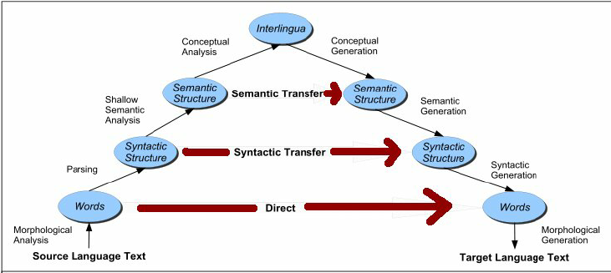
Vauquois Triangle
(Vauquois, 1968)

Slide 15
Classical MT
Direct translation model (lookups, phrase tables)
Some local reordering included
i.e. I am eating the apple. -> Je mange la pomme.
Transfer model (syntactic MT)
Transform the parse tree
i.e. English to Spanish; NP -> JJ NN becomes NP -> NN JJ
i.e. The green witch -> La bruja verde
Interlingua model (holy grail?)
Extract meaning
Event-based representation

Slide 16
Statistical MT
End goal: evaluate P(hello | bonjour)
A taste of “understandable models don’t work very well… and end up being so complicated, they aren’t even understandable”.

Slide 17
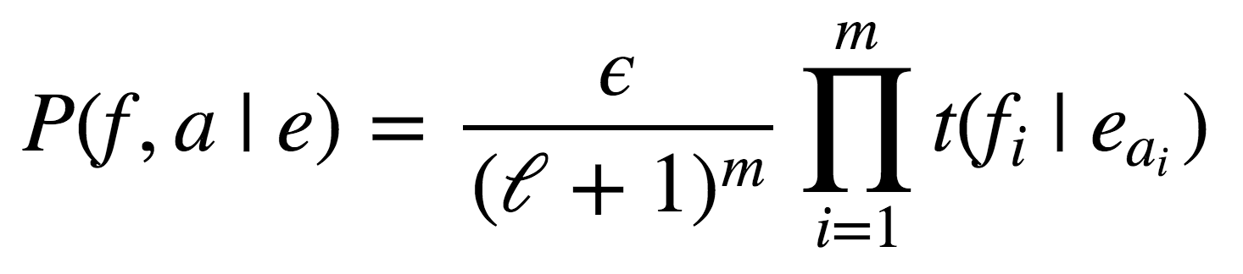
IBM Model 1
the
blue
house
NULL
Noisy-channel translation f → e
Model: generative process e → f with P(f | e)
Sample a length m ∼ Q(m)
Distribution Q(m) doesn’t matter!
Sample an alignment {a_{i}} for i = 1,...,m
a_{i} ∼ Uniform(0, ℓ + 1)
a_{i} independent
Sample a word f_{i} from t(f | e_{ai})
t(f | e) tabulated
la
maison
bleue

Slide 18
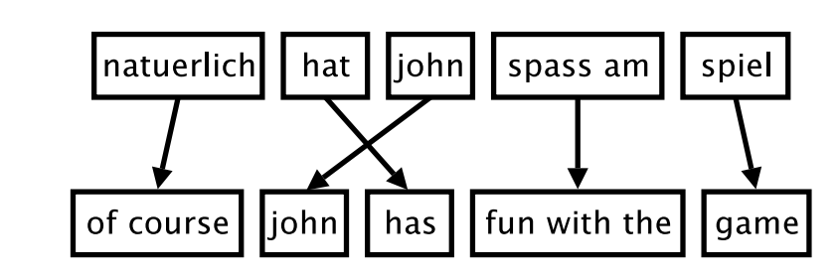
Phrase-Based MT
Problem: words are not independent!
Common patterns: [eat apples] ↔ [manger des pommes]
Idiomatic or non-compositional: [kick the bucket] ↔ [casser sa pipe]
Idea: translate in larger chunks - phrase units
Pre-segment input(s)
Translate each segment
(inference) beam decode

Slide 19
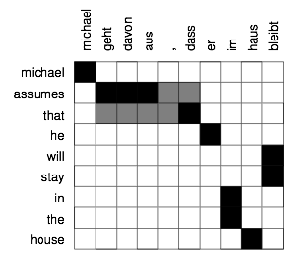
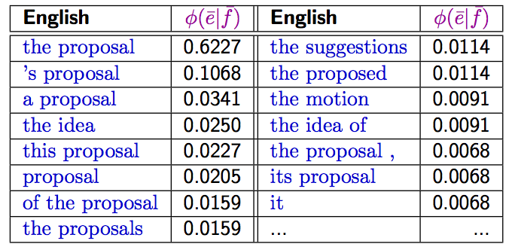
Phrase-Based MT
Generate phrases by heuristics or ML
Variable length
No linguistic constraints
Koehn (2009) Statistical Machine Translation

Slide 20
Evaluation Metrics: BLEU

Slide 21
Evaluating Machine Translation
Ideal: human judgments
Adequacy: does this capture the information?
Fluency: is this a good sentence?
Gold standard: pay humans to rate output

Slide 22
BLEU motivation
Why is an automated eval important for machine translation?
What makes automated evaluation hard?
What makes us think that evaluation is possible?
Notes:
Desiderate: low cost, tunable, meaningful, consistent, correct (correlates with humans)

Slide 23
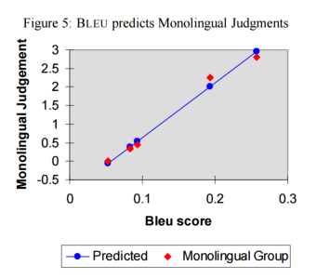
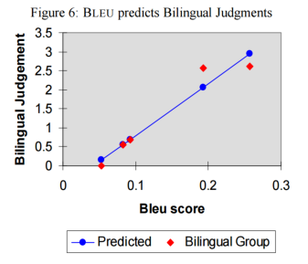
Evaluation seems possible!
BLEU: http://aclweb.org/anthology/P02-1040.pdf (IBM, 2002)

Slide 24
BLEU motivation
Why is an automated eval important for machine translation?
Problem: humans are expensive, slow, & inconsistent
What makes automated evaluation hard?
What makes us think that evaluation is possible?

Slide 25
Brainstorming: “How Would You Build A Simple Eval Model?”
Let’s think through an approach...
Machine Translation candidates: - “this horse is a good one to to to ride”
- “fine horse”
Vs ‘correct’ Reference: “the horse over there is fine to ride”
Are they good? Which one is better How would we evaluate… simply?
...
...

Slide 26
BLEU formulation
Idea #1: Precision
How many of the words in the candidate translation occur in a reference?

Slide 27
BLEU formulation
Idea #1: Precision
How many of the words in the candidate translation occur in a reference?
Problem:
Candidate: the the the
Reference: the cow jumped over the moon
Precision?

Slide 28
BLEU formulation
Idea #2: Max credit
How many of the words in the candidate translation occur in a reference?
(Cap numerator of precision by # of times the word is seen in reference.)
Better:
Candidate: the the the the the the
Reference: the cow jumped over the moon
Precision?

Slide 29
BLEU formulation
Idea #3: Unigrams are too small of a unit
How many of the words in the candidate translation occur in a reference?
(Cap numerator of precision by # of times word seen in reference.)
(<= 4-grams)
Smaller n-grams stop correlating with monolingual judgements on fluency.
N-gram overlap helps enforce loosely-consistent word ordering.

Slide 30
BLEU formulation
Idea #4: Brevity Penalty
How many of the words in the candidate translation occur in a reference?
(Cap numerator of precision by # of times word seen in reference.)
(<= 4-grams)
(Trivial translations are likely bad)
Penalty = exp ( min(0, 1 - ref_len / mt_len) )

Slide 31
BLEU formulation
Extensions:
Sentence level (requires smoothing of zero counts)
Multiple reference sentences (standard for old NIST evaluations)
How long to optimize for?
Compare references against one another is a good measure of benchmark usefulness

Slide 32
Automatic Evaluation TL;DR
BLEU: N-gram precision (n = 1,2,3,4) plus brevity penalty
Correlates well between related systems
Weaker correlation across different systems (rules, PBMT, neural)
Possible to over-optimize, lose correlation with human judgment
Lots of known shortcomings: word importance, re-ordering
Ideally, tune on BLEU then run human evals at end
See recent works from Google, MS, WMT workshops, etc.

Slide 33
Beyond BLEU
BLEURT
Use BERT to learn to predict the score a human evaluator will give to a pair of reference and candidate outputs.
Pretrain BERT as usual AND on altered Wikipedia sentences (synthetic sentence pairs)
Fine-tune on WMT human ratings
BERTScore
Use BERT contextual embeddings to compute the pairwise cosine similarity of words in each reference and candidate pair
Compute Precision, Recall, and F1 for each pair
High Pearson’s Correlation with human judgements

Slide 34
Neural Machine Translation

Slide 35
Sequential Neural Models
Sequence Annotation Model
Sequence to Vector Model
Vector to Sequence Model
Encoder Decoder Model

Slide 36
Neural seq2seq Models for MT
Google’s GNMT system: https://translate.google.com/
End-to-End Sequence-to-Sequence models:
Input: source language sentence
Output: target language sentence
the
blue
house
</s>
la
maison
bleue
</s>
<s>
the
blue
house

Slide 37
Questions
Training
What is the input to the model?
What would be a natural cost function?
Inference
What is the input to the model now?
In fact, can you use the exact same model?
For some code, see: https://blog.keras.io/a-ten-minute-introduction-to-sequence-to-sequence-learning-in-keras.html

Slide 38
Questions
“That works??”
Yup… certainly surprisingly well
“What do we do with the previous hidden encoder states? And could we use the final state differently?”

Slide 39
Questions
“That works??”
Yup… certainly surprisingly well
“What do we do with the previous hidden encoder states? And could we use the final state differently?”
In this model… throw them away
The state can be used in different ways in the encoder. Many options..
“Any bigger issues?”

Slide 40
Questions
“That works??”
Yup… certainly surprisingly well
“What do we do with the previous hidden encoder states? And could we use the final state differently?”
In this model… throw them away
The state can be used in different ways in the encoder. Many options..
“Any bigger issues?”
Quality goes down with sentence length >~25-ish
Does not parallelize well. Slow to train!

Slide 41
Questions
“That works??”
Yup… certainly surprisingly well
“What do we do with the previous hidden encoder states? And could we use the final state differently?”
In this model… throw them away
The state can be used in different ways in the encoder. Many options..
“Any bigger issues?”
Quality goes down with sentence length >~25-sh
Does not parallelize well. Slow to train!
Attention!
Transformer Model

Slide 42
Paper Peek 1
-> Sequence to Sequence Learning with Neural Networks<-
Notes:
discussion of grounding problem, ambiguity in language

Slide 43
Attention Idea: All in One Vector?
the
blue
house
</s>
la
maison
bleue
</s>
<s>
the
blue
house

Slide 44
Attention Idea: Looking Back!
the
blue
house
</s>
la
maison
bleue
</s>
<s>
the
blue
house
More specifically: “Using a vector d_{t} created in the Decoder at position/time t , and the set of e_{s} of Encoder outputs to create pointers to ‘where to look in the source text’ to inform generating the next translation token”

Slide 45
Brainstorming: “What are Options to create ‘Attention’ distribution”
Let’s think through approach(es) to build a probability distribution across the source tokens using (alpha and beta are refer to the vector indices):
A ‘query’ vector d_{t}^{𝞪}
The set of ‘key’ vectors e_{s}^{β}
d^{𝞪} e^{β}
=> i) sum_alpha(d^{𝞪} e^{𝞪}) ii) sum_(alpha, beta) (d^{𝞪} W ^{𝞪β} e^{β}) iii) v W concat(d, e)

Slide 46
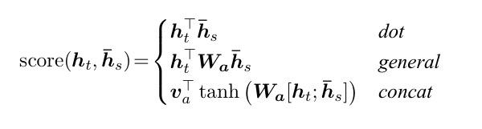
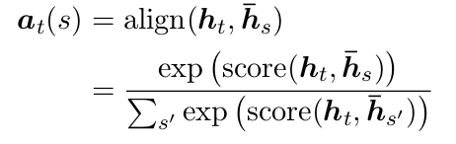
Alternative Attention Score Calculations
Luong et. al experiment with multiple scoring functions
This attention framework is probably the most common one and is very close to what is used in Transformer architectures.
This attention framework is very similar to the one used in Bahdanau et. al and a number of other papers.

Slide 47
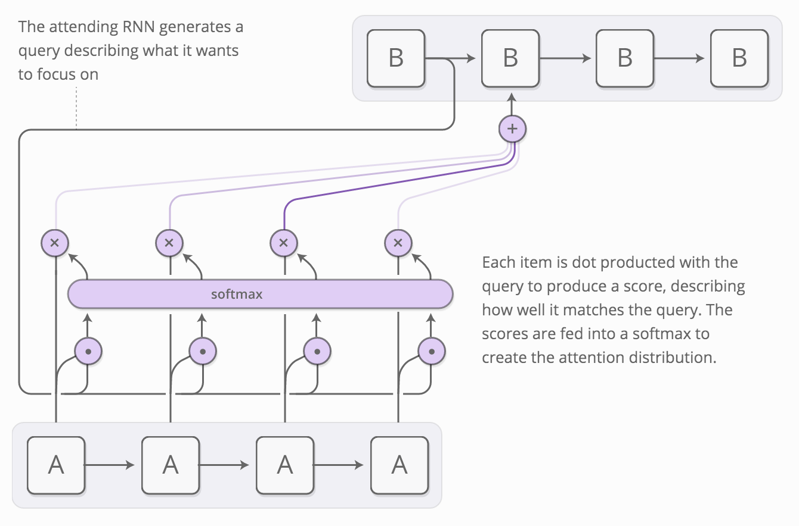
Attention Mechanism
Problem: fixed-length vector representation
Bad for long sentences!
Idea: allow model to look back at input sequence during decoding
Acts as a sort of “memory”
Cognitively plausible?
Bonus: get alignments! (or something like them)
Image by Chris Olah and Shan Carter

Slide 48
Simple Sample Attention Calculation (Dot Product)
1
Decoder “Query” h_{t-1}^{(D)}
.5

Slide 49
Simple Sample Attention Calculation (Dot Product)
1
Decoder “Query” h_{t-1}^{(D)}
Compare to all Encoder outputs h_{i}^{(E)} (“Keys”)
.5
1
1
-1
2

Slide 50
Simple Sample Attention Calculation (Dot Product)
1
Decoder “Query” h_{t-1}^{(D)}
Compare to all Encoder outputs h_{i}^{(E)} (“Keys”)
.5
1
1
-1
2
Score: 0.5 2

Slide 51
Simple Sample Attention Calculation (Dot Product)
1
Decoder “Query” h_{t-1}^{(D)}
Compare to all Encoder outputs h_{i}^{(E)} (“Keys”)
.5
1
1
-1
2
Score: 0.5 2
Softmax: 0.18 0.82

Slide 52
Simple Sample Attention Calculation (Dot Product)
1
Decoder “Query” h_{t-1}^{(D)}
Compare to all Encoder outputs h_{i}^{(E)} (“Keys”)
.5
1
1
-1
2
Score: 0.5 2
For use in Decoder to compute P(y_{t})...
Softmax: 0.18 0.82
1
1
1
Attention Vector:
weighted sum of 0.18 + 0.82 =
the Values
(which are also Keys here)
-1
2
1.46

Slide 53
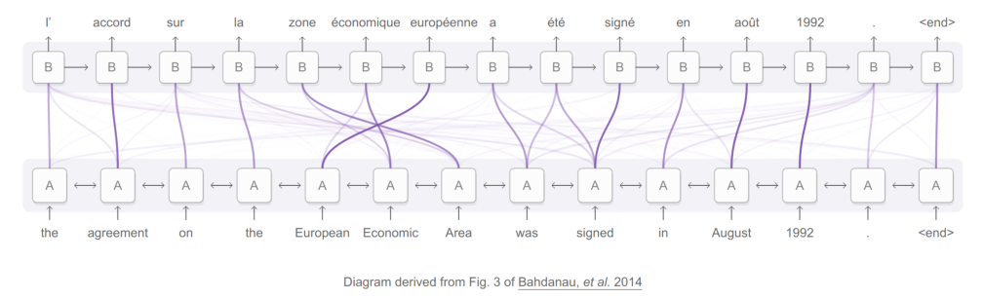
Attention Models: Example

Slide 54
Attention Demo
-> go here

Slide 55
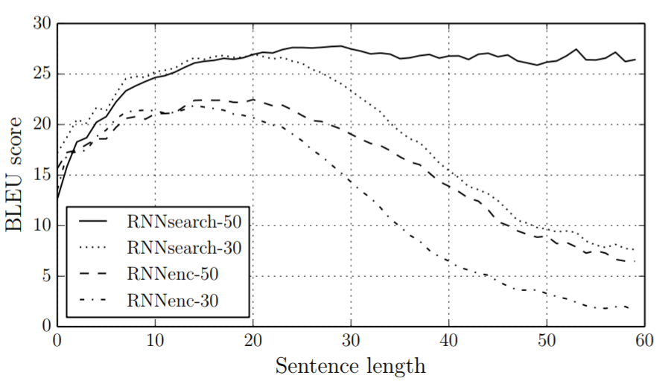
Paper Peek 2
-> NEURAL MACHINE TRANSLATION BY JOINTLY LEARNING TO ALIGN AND TRANSLATE<-
Notes:
discussion of grounding problem, ambiguity in language

Slide 56
Comments on Attention
Multiple ways to derive weights (dot product, modified dot product,..)
Multiple ways to use context vectors in Decoder (concatenate with other cell inputs, concatenate with cell output,...)
Nomenclature in some literature:
‘Inquiring’ vector: ‘Query’
Vectors to compare against to derive weight: ‘Keys’
Vectors used in linear combination for attn vector: ‘Values’

Slide 57
Beam Search

Slide 58
Beam Search
Imagine you have a greedy translation system… (or any sequence generation system) What if ‘blue’ or even ‘the’ are completely wrong? Can I recover?
the
green
house
</s>
la
maison
bleue
</s>
<s>
the
green
house

Slide 59
Beam Search - Problem Statement
Correct translation: “I want to fly to the moon”
System correctly generated: “I want to” ...
… but next word’s probability distribution:
P₄(buy) = 0.03
P₄(‘fly’) = 0.01
What do you pick?

Slide 60
Beam Search - Problem Statement
Correct translation: “I want to fly to the moon”
System correctly generated: “I want to” ...
… but next word’s probability distribution:
P₄(buy) = 0.03
P₄(‘fly’) = 0.01
‘buy’ is highest, so we should(?) pick that one...
… but what if
∀_{X}P₄₅(‘buy’, X) < P₄₅(‘fly’, ‘to’)? Sub-optimal solution! Too late!

Slide 61
What Can We Do?
Keep top candidates?
That is the issue… efficient but highly non-optimal
Keep all candidates at all steps?
Optimal! But if vocab length V, sentence length L … how many items to keep?
V^{L} ! Oy… impossible

Slide 62
Beam Search To The Rescue
Beam Search: Don’t fully commit.. leave fixed number of options in play !
Keep Top N candidates at each step i…
… calculate for each candidate the next word’s probability distribution, keep top N of those
… that gives N*L new combined candidates at step i+1
… and keep Top N of those
… keep doing this Simple!

Slide 63
Beam Search - Example (N = 2)
Step 1
P(‘the’) = 0.07 P(‘a’) = 0.04 P(‘one’) = 0.01 …..

Slide 64
Beam Search - Example (N = 2)
Step 1
P(‘the’) = 0.07 P(‘a’) = 0.04 P(‘one’) = 0.01 …..
X
X

Slide 65
Beam Search - Example (N = 2)
Step 2
P(‘the’) = 0.07 P(‘the’, ‘car’) = 0.010 P(‘a’) = 0.04 P(‘a’, ‘car’) = 0.006 P(‘a’, ‘bike’) = 0.002 P(‘the’,’horse’) = 0.001
….

Slide 66
Beam Search - Example (N = 2)
Step 2
P(‘the’) = 0.07 P(‘the’, ‘car’) = 0.010 P(‘a’) = 0.04 P(‘a’, ‘car’) = 0.006 P(‘a’, ‘bike’) = 0.002 P(‘the’,’horse’) = 0.001
...
X
X
X

Slide 67
Beam Search - Example (N = 2)
Step 3
P(‘the’) = 0.07 P(‘the’, ‘car’) = 0.010 P(‘the’, ‘car’, ’is’) = 0.004 P(‘a’) = 0.04 P(‘a’, ‘car’) = 0.006 P(‘the’, ‘car’, ’was’)=0.003 P(a, ‘car’, ‘should’)=0.002 P(‘a’, ‘car’, ‘could’)=0.001
...
X
X
X

Slide 68
Beam Search - Example (N = 2)
Step 3
P(‘the’) = 0.07 P(‘the’, ‘car’) = 0.010 P(‘the’, ‘car’, ’is’) = 0.004 P(‘a’) = 0.04 P(‘a’, ‘car’) = 0.006 P(‘the’, ‘car’, ’was’)=0.003
Not ‘optimal’ but very good and stable memory need
Beam sizes: tunable hyper-parameter!

Slide 69
That’s it for MT and Alignment!

Slide 70
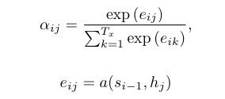
Alternative Attention Score Calculations
Luong et. al experiment with multiple scoring functions
Bahdanau et. al use additive/concat scoring function (for alignment)
Where a is a feedforward network jointly trained with rest of the system.

Slide 71
IBM Alignment Models
The critical hypothesis: all content is in the target language. A noisy channel “corrupts” some material into the source language.
If we can model the statistical properties of the corruption, we can find the most likely source material that ended up corrupted in the way we’ve found the material.
P(e)
p(a | e)
P(a | e)
t(f | e)
P(f | a, e)
Generation
(never used)

Slide 72
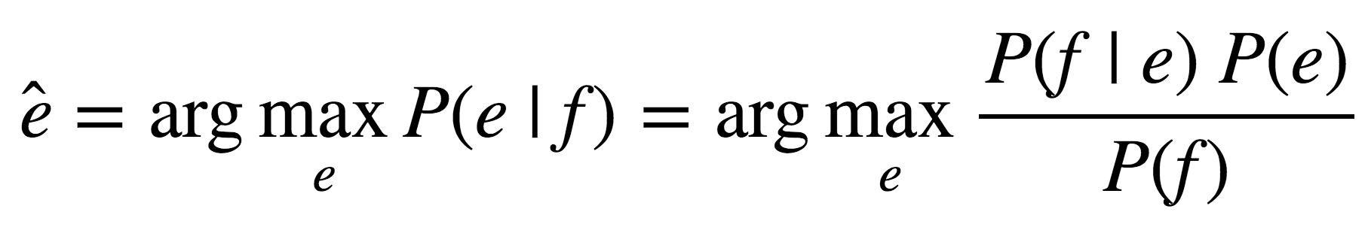
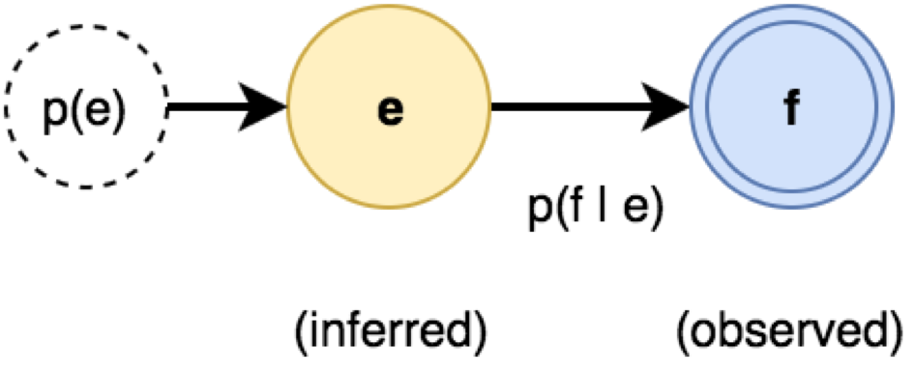
The Noisy Channel Model
For Machine Translation, translate f → e
P(e) : source (language model)
P(f|e) : channel (translation model)
“...one naturally wonders if the problem of translation could conceivably be treated as a problem in cryptography. When I look at an article in Russian, I say: ‘This is really written in English, but it has been coded in some strange symbols. I will now proceed to decode.’ ”
Warren Weaver, 1947
Notes:
3 parts to the model: P(e): the language model, P(f|e): the translation model, P(e|f): decoder

Slide 73
IBM Alignment Models
The critical hypothesis: all content is in the target language. A noisy channel “corrupts” some material into the source language.
One (dubious) claim about how this noisy channel works:
Alignment: Randomly reorder the tokens
Token translation: Randomly substitute tokens from the source language for tokens of the target language
P(e)
p(a | e)
P(a | e)
t(f | e)
P(f | a, e)
Generation
(never used)

Slide 74
IBM Alignment Models and Training
EM Mechanism & IBM Model 1:
Key concepts: alignment & translation probabilities
Training:
Use parallel sentence translations
Start with uniform alignment probabilities
With these, calculate translation likelihoods
Use those to re-adjust alignment probabilities
Use those to ….
ITERATION!
Good intuition, but many limitations in IBM models

